Slide 1
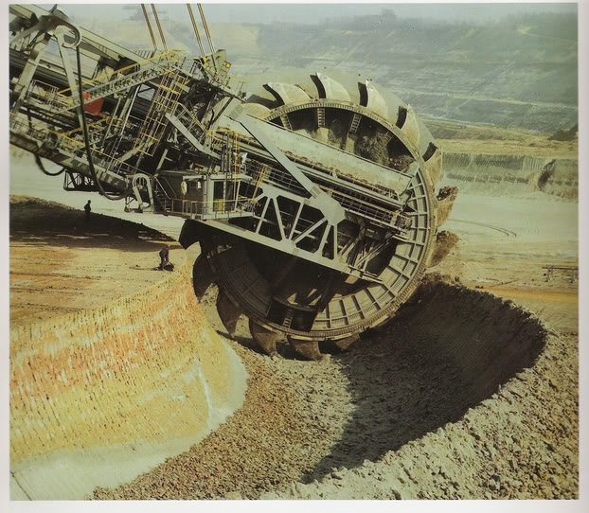
Big Data
What Is It, and Why Should I Care?

Slide 2




Demystifying Big Data Jonathan Mills

Slide 3
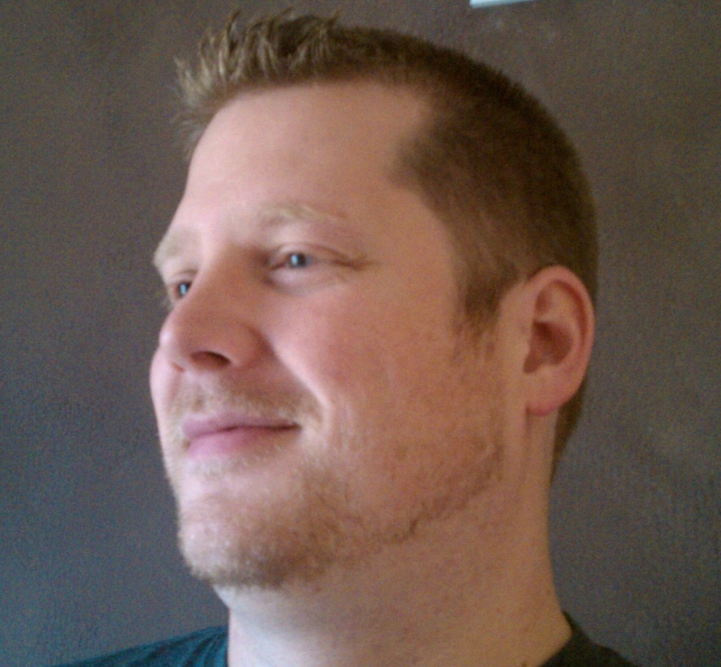
Who Is This Guy?
Research and Development \
Paige Technologies
@jonathanfmills
Jonathanfmills.com
Notes:
A little about me
As a manager, I should not have to supervise the work of others……
As a manager, I am responsible for making the team the most efficient team they can be
Over the long term… Sticks don’t work over long term
Make sure they want to come to work every morning
Make sure they feel appreciated.

Slide 4
Big data is like teenage sex: everyone talks about it, nobody really knows how to do it,
everyone thinks everyone else is doing it, so everyone claims they are doing it...

Slide 5
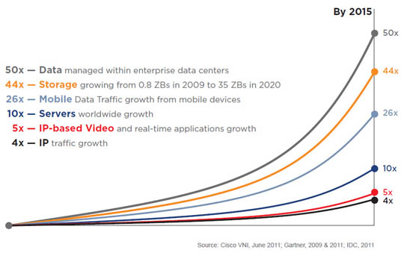
Why Big Data?

Slide 6



Slide 7
Slq Server can handle databases over 3 PB

Slide 8


Slide 9
Big Table
DynamoDB

Slide 10

What Is Big Data?

Slide 11
V
V
V

Slide 12
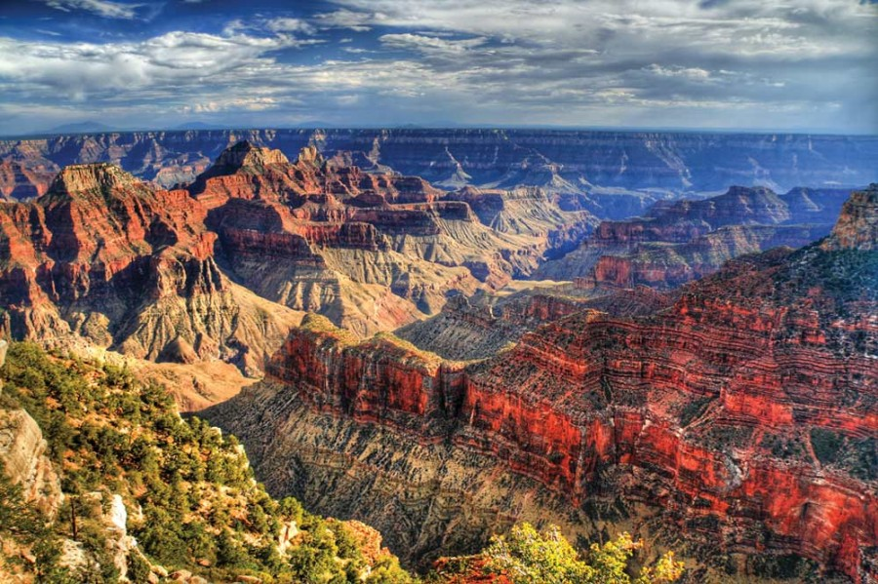
Volume
….

Slide 13
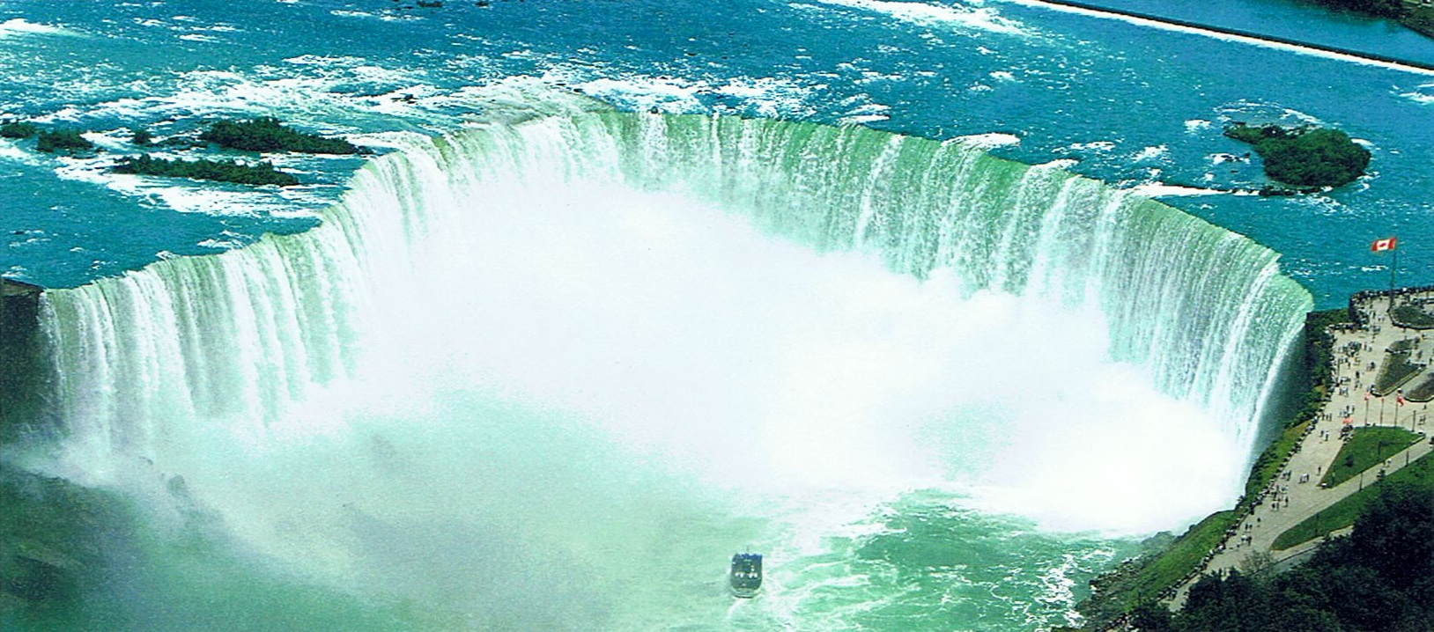
Velocity
Notes:
Velocity
Data Flow
Internet of things…
Streaming Data
Twitter – tweets per minute
Cerner for sepsis

Slide 14
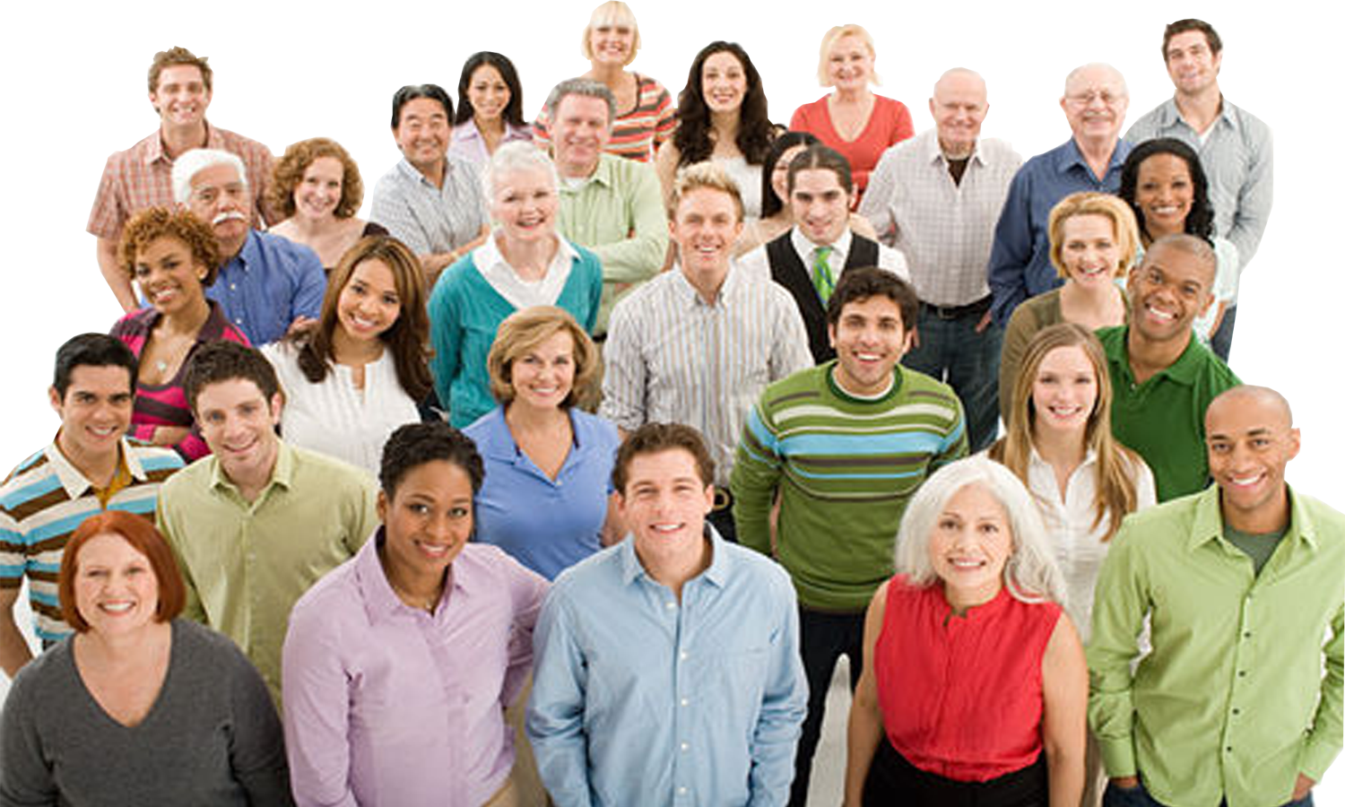
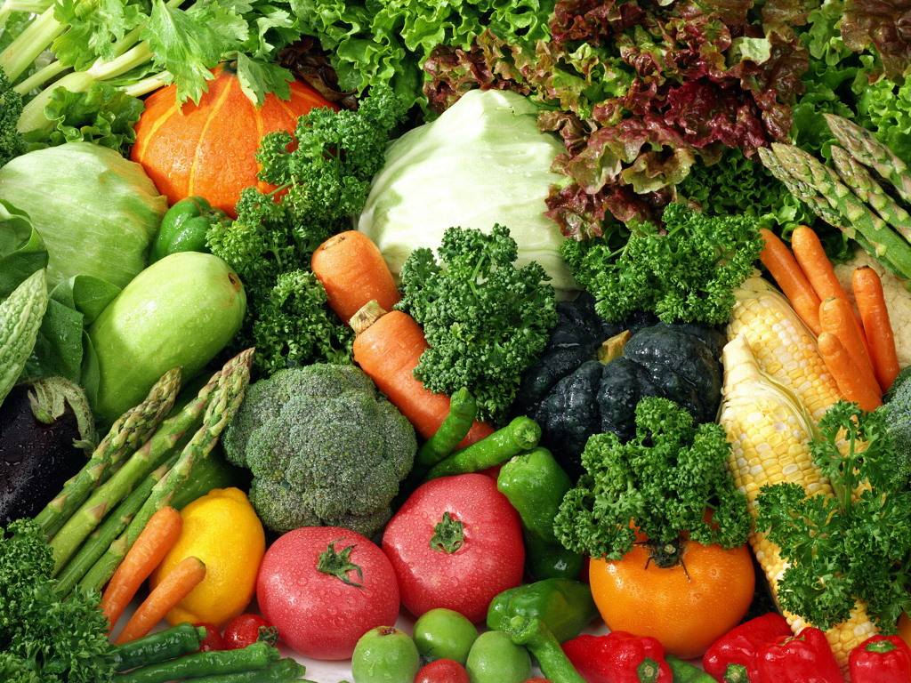
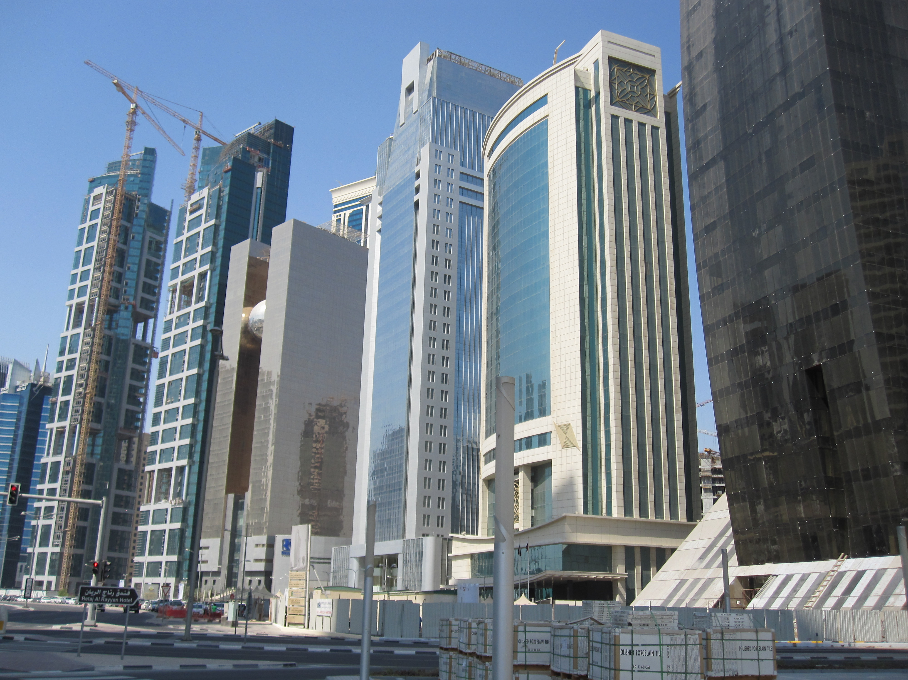
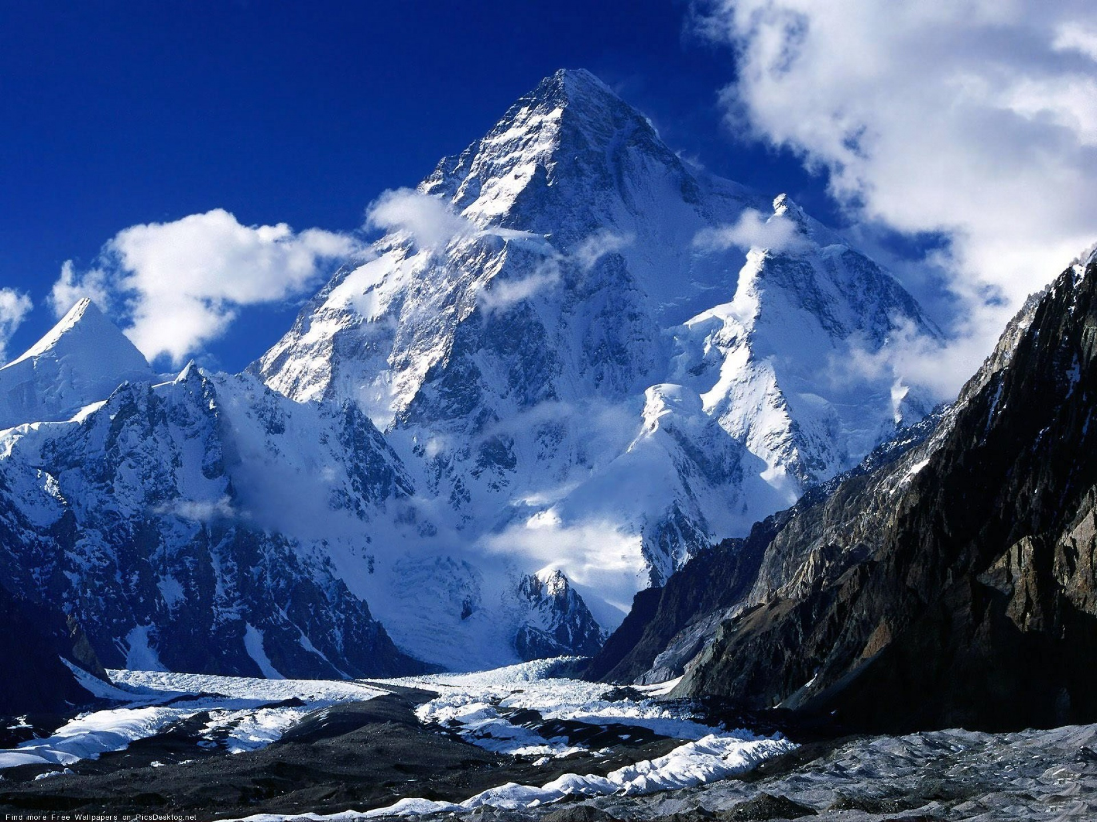
Variety
Notes:
Documents, Finances, Personal Files…
But now add photos, AV, 3d Models, Location Data
Can’t categorize -- unstructured

Slide 15

Notes:
What is Hadoop?
Doug Cutting Nutch spider scrawler….
Open Source Version of Google’s Map reduce plus HDFS File system for managing the data.
3 Copies of everything.
All these servers have disk and CPU. So instead of pulling the data to the code, you push the code to the data

Slide 16
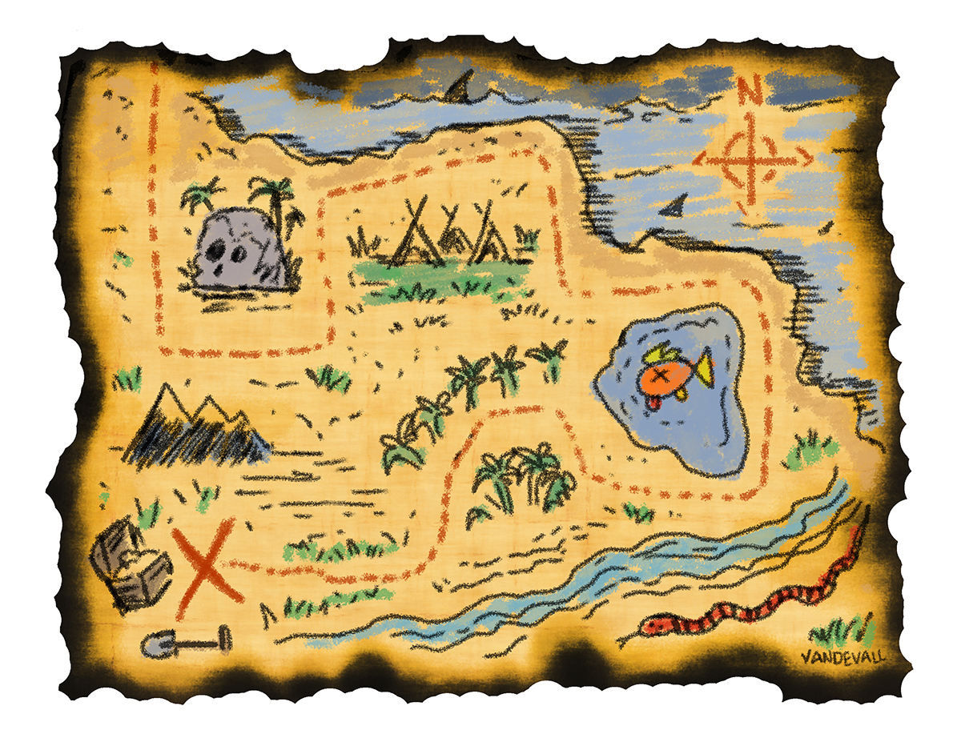
Map Reduce
Notes:
Google Developed
Hadoop is the open source version of MapReduce
Map Step
Split the Data and PreProcess
Reduce Step
Aggregate the results

Slide 17
Map Reduce?

Slide 18


Notes:
Cloudera, Doug Cutting Co-Creator of Hadoop is the – Architect at Cloudera. He pulled some people with him.
The Original team was at Yahoo and they where spun off into Hortonworks

Slide 19
Hadoop vs NoSql
Notes:
Hadoop does data aggregation, nosql is for simple selects….

Slide 20
Why NoSql?
Notes:
Johan Oskarsson in 2009 organizing an event

Slide 21
#

Slide 22
NoSql Characteristics
Non-Relational
Open-Source
Cluster Friendly
21st Century
Schema-less

Slide 23










Slide 24
Document
Column
Family
Graph
Key Value

Slide 25
Key-Value
1234
1235
1236
1237
1238

Slide 26

Document

Slide 27
Document
{
"_id": {
"$oid": "515d9885e4b035b7009ddc1c"
},
"id": 9948,
"name": "Managing Developers",
"level": 100,
"length": "1 Hour",
"synopsis": “",
"room": 2207,
"slot": "Saturday 9:40",
"speakerName": "Jonathan Mills",
"speakerId": 9912
}
Notes:
Refferential Integrity
No Schema / Implied Schema

Slide 28
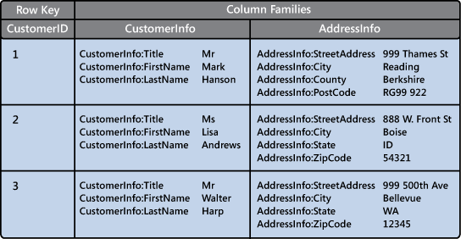
Column Family
Notes:
Keep like items on the same instance

Slide 29
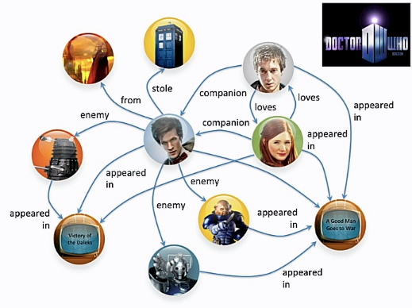
Graph DBS

Slide 30


Why Would I Do This?
Customer Insight

Slide 31
What Is The Next Netflix Series?
Political Dramas
British Shows
Kevin Spacey
David Fincher
Notes:
David Fincher – Alien3, Seven, The Girl With The Dragon Tattoo, Zodiac, The Game….

Slide 32
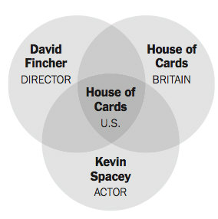
House Of Cards?

Slide 33
Why Would I Do This?
Customer Insight
Forecasting trends

Slide 34
Why Would I Do This?
Customer Insight
Forecasting trends
Healthcare trends

Slide 35
Why Would I Do This?
Customer Insight
Forecasting trends
Healthcare trends
Closer To Home….

Slide 36
Why Should I Care?
Evade The Hype…..

Slide 37
Don’t start with the data….
Start with a need… use data as a solution.

Slide 38
Why Should I Care?
Is your data really big? Are you collecting enough to matter?
Should your data be big?
Does the insight your data could provide really matter?
Are you ready for the volume you will get if you collect it? – Its about filtering and Ignoring…

Slide 39
Ignore does not mean throw away
Collect your data, and brainstorm for how you should use it.

Slide 40
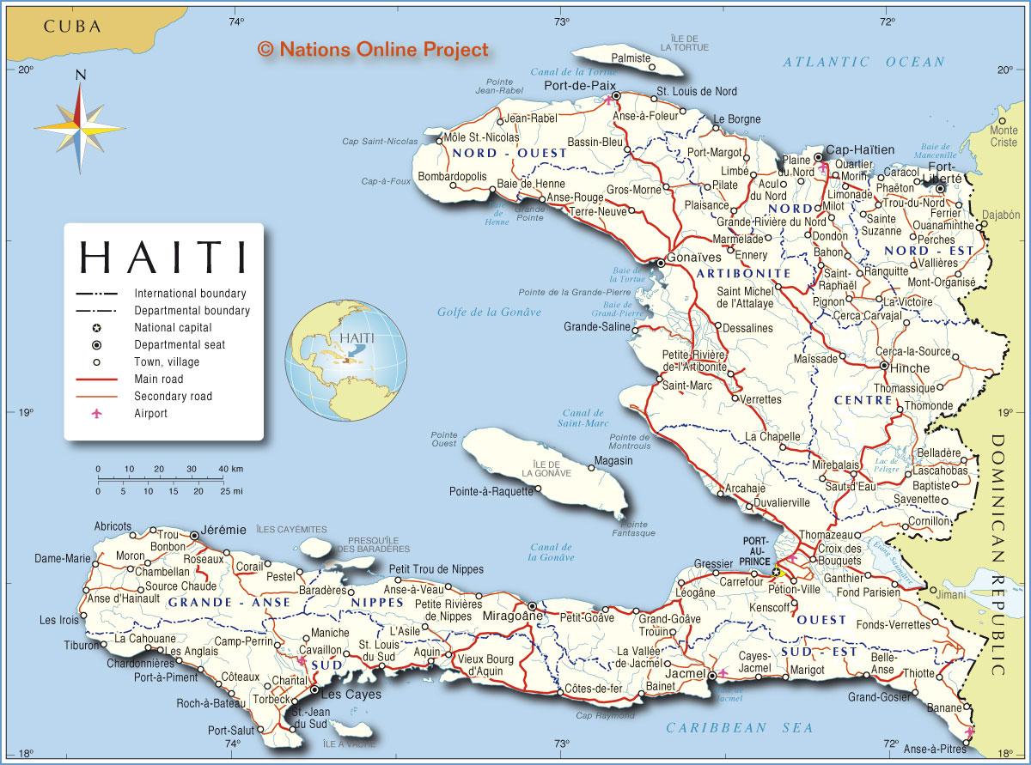
Be A Skeptic

Slide 41
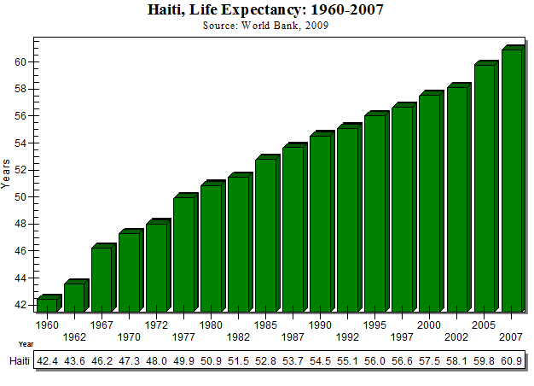
Notes:
The data was not flawed. The assumptions based on the data was bad.

Slide 42
Questions?

Slide 43
Who Is This Guy?
Research and Development \
Paige Technologies
@jonathanfmills
Jonathanfmills.com
Notes:
A little about me
As a manager, I should not have to supervise the work of others……
As a manager, I am responsible for making the team the most efficient team they can be
Over the long term… Sticks don’t work over long term
Make sure they want to come to work every morning
Make sure they feel appreciated.

